Slide 1
ITC 504 SOFTWARE ENGINEERING

Slide 2
Course Objectives
To provide the knowledge of software engineering discipline.
To understand Requirements and analyze it
To do planning and apply scheduling
To apply analysis, and develop software solutions
To demonstrate and evaluate real time projects with respect to software engineering principles
Apply testing and assure quality in software solution.

Slide 3
Course Outcomes
Understand and use basic knowledge in software engineering.
Identify requirements, analyze and prepare models.
Plan, schedule and track the progress of the projects.
Design & develop the software solutions for the growth of society
To demonstrate and evaluate real time projects with respect to software engineering principles
Apply testing and assure quality in software solution

Slide 4
Grading
Internal Assessment | 20 Marks
Continuous Assessment | 20 Marks
Theory | 60 Marks
Total | 100 Marks
Text Book:
Roger S. Pressman, Software Engineering: A practitioner's approach, McGraw Hill

Slide 5
What is Software?
Software is
(1) instructions (computer programs) that when executed provide desired function and performance
(2) data structures that enable the programs to adequately manipulate information
(3) documents that describe the operation and use of the programs.
Software products can be Generic or Custom

Slide 6
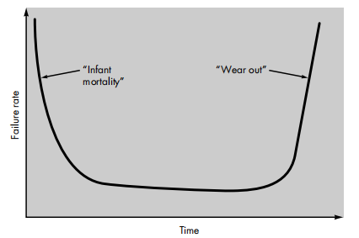
Software Characteristics
Software is a logical rather than a physical system element. Therefore, software has characteristics that are considerably different than those of hardware:
1. Software is developed or engineered, it is not manufactured in the classical sense.

Slide 7
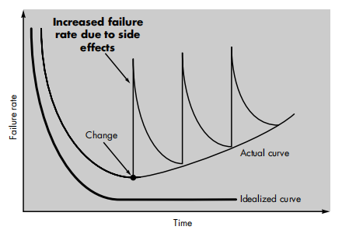
Software Characteristics
2. Software doesn't "wear out."
Notes:
The first ARPANET link was established between the University of California, Los Angeles and the Stanford Research Institute on 22:30 hours on October 29, 1969
Store and forward, i.e. packet switching
Usenet is a world-wide distributed discussion system. It consists of a set of "newsgroups" with names that are classified hierarchically by subject. "Articles" or "messages" are "posted" to these newsgroups by people on computers with the appropriate software -- these articles are then broadcast to other interconnected computer systems via a wide variety of networks. Some newsgroups are "moderated"; in these newsgroups, the articles are first sent to a moderator for approval before appearing in the newsgroup. Usenet is available on a wide variety of computer systems and networks, but the bulk of modern Usenet traffic is transported over either the Internet or UUCP.

Slide 8
Software Characteristics
3. Although the industry is moving toward component-based assembly, most software continues to be custom built.
Notes:
The first ARPANET link was established between the University of California, Los Angeles and the Stanford Research Institute on 22:30 hours on October 29, 1969
Store and forward, i.e. packet switching
Usenet is a world-wide distributed discussion system. It consists of a set of "newsgroups" with names that are classified hierarchically by subject. "Articles" or "messages" are "posted" to these newsgroups by people on computers with the appropriate software -- these articles are then broadcast to other interconnected computer systems via a wide variety of networks. Some newsgroups are "moderated"; in these newsgroups, the articles are first sent to a moderator for approval before appearing in the newsgroup. Usenet is available on a wide variety of computer systems and networks, but the bulk of modern Usenet traffic is transported over either the Internet or UUCP.

Slide 9
Goal and Objectives of Software
1. Satisfy the user Requirements.
2. High Reliability.
3. Low maintenance cost.
4. Delivery on time.
5. Low production costs.
6. High Performance.
7. Ease of Reuse
Notes:
The first ARPANET link was established between the University of California, Los Angeles and the Stanford Research Institute on 22:30 hours on October 29, 1969
Store and forward, i.e. packet switching
Usenet is a world-wide distributed discussion system. It consists of a set of "newsgroups" with names that are classified hierarchically by subject. "Articles" or "messages" are "posted" to these newsgroups by people on computers with the appropriate software -- these articles are then broadcast to other interconnected computer systems via a wide variety of networks. Some newsgroups are "moderated"; in these newsgroups, the articles are first sent to a moderator for approval before appearing in the newsgroup. Usenet is available on a wide variety of computer systems and networks, but the bulk of modern Usenet traffic is transported over either the Internet or UUCP.

Slide 10
Nature/Types of Software
System software: System software is a collection of programs written to service other programs.
Some processes complex, but determinate, information structures. Eg: compilers, editors, and file management utilities
Some processes largely indeterminate data. Eg:, operating system components, drivers, telecommunications processors

Slide 11
Nature/Types of Software
Real-time software: Software that monitors/analyzes/controls real-world events as they occur is called real time.
real-time response (typically ranging from 1 millisecond to 1 second) can be maintained.

Slide 12
Nature/Types of Software
Business software: Business information processing is the largest single software application area. Discrete "systems" (e.g., payroll, accounts receivable/payable, inventory) have evolved into management information system (MIS) software that accesses one or more large databases containing business information.

Slide 13
Nature/Types of Software
Engineering and scientific software: Engineering and scientific software have been characterized by "number crunching" algorithms. Applications range from astronomy to volcanology, from automotive stress analysis to space shuttle orbital dynamics, and from molecular biology to automated manufacturing

Slide 14
Nature/Types of Software
Embedded software: Embedded software resides in read-only memory and is used to control products and systems for the consumer and industrial markets

Slide 15
Nature/Types of Software
Web-based software: The Web pages retrieved by a browser are software that incorporates executable instructions (e.g., CGI, HTML, Perl, or Java), and data (e.g., hypertext and a variety of visual and audio formats).
In essence, the network becomes a massive computer providing an almost unlimited software resource that can be accessed by anyone with a modem.

Slide 16
Nature/Types of Software
Personal computer software: Word processing, spreadsheets, computer graphics, multimedia, entertainment, database management, personal and business financial applications, external network, and database access are only a few of hundreds of applications

Slide 17
Nature/Types of Software
Artificial intelligence software: Artificial intelligence (AI) software makes use of nonnumerical algorithms to solve complex problems that are not amenable to computation or straightforward analysis. Expert systems, also called knowledge based systems, pattern recognition (image and voice), artificial neural networks, theorem proving, and game playing are representative of applications within this category.

Slide 18
Software engineering
Software process is a framework for the tasks that are required to build high-quality software.
Is process synonymous with software engineering?
A software process defines the approach that is taken as software is engineered.
Software Engineering:
(1) The application of a systematic, disciplined, quantifiable approach to the development, operation, and maintenance of software; that is, the application of engineering to software.
(2) The study of approaches as in (1)

Slide 19
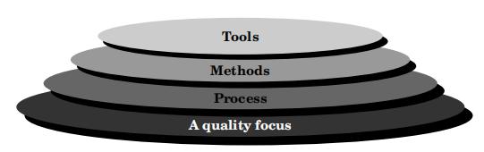
Software engineering:Layered technology
A disciplined quality management is a backbone of software engineering technology. The foundation for software engineering is the Process layer. Software engineering process is the glue that holds the technology layers together and enables rational and timely development of computer software. Process defines a framework for a set of key process areas.

Slide 20
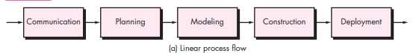
Process Flow

Slide 21
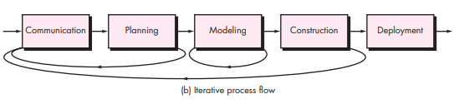
Process Flow

Slide 22
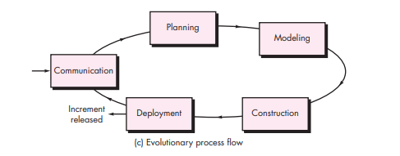
Process Flow

Slide 23
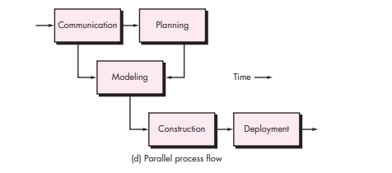
Process Flow

Slide 24
Software engineering:Layered technology
Software engineering Methods provide the technical how-to's for building software. Methods encompass a broad array of tasks that include requirements analysis, design, program construction, testing, and support. Software engineering methods rely on a set of basic principles that govern each area of the technology and include modeling activities and other descriptive techniques.

Slide 25
Software engineering:Layered technology
Software engineering tools provide automated or semi-automated support for the process and the methods. When tools are integrated so that information created by one tool can be used by another, a system for the support of software development, called computer-aided software engineering, is established. CASE combines software, hardware, and a software engineering database (a repository containing important information about analysis, design, program construction, and testing) to create a software engineering environment analogous to CAD/CAE (computer-aided design/engineering) for hardware.

Slide 26
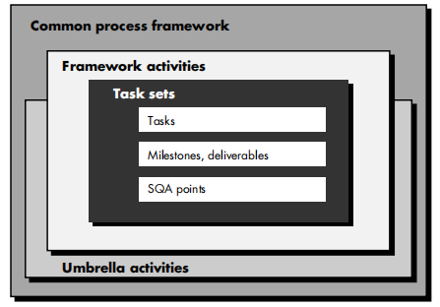
The Software Process
Common Process Framework is established by defining a small number of framework activities that are applicable to all software projects, regardless of their size or complexity.
Process Framework activities: Communication, Planning, Modelling, Construction, Deployment.

Slide 27
The Software Process
Task Set:
Collection of Software Engineering work tasks
Project milestones
Software quality assurance points

Slide 28
The Software Process
Umbrella activities:
Software project tracking and control
Risk Management
Software quality assurance
Formal technical reviews
Software configuration management
Work product preparation and production
Reuasabiltiy management

Slide 29
The Capability Maturity Model
Software Engineering Institute (SEI) has developed a comprehensive model predicated on a set of software engineering capabilities that should be present as organizations reach different levels of process maturity. To determine an organization’s current state of process maturity, the SEI uses an assessment that results in a five point grading scheme. The grading scheme determines compliance with a capability maturity model (CMM) that defines key activities required at different levels of process maturity. The SEI approach provides a measure of the global effectiveness of a company's software engineering practices and establishes five process maturitylevels that are defined in the following manner:

Slide 30
The Capability Maturity Model
Level 1: Initial
Level 2: Repeatable
Level 3: Defined
Level 4: Managed
Level 5: Optimizing

Slide 31
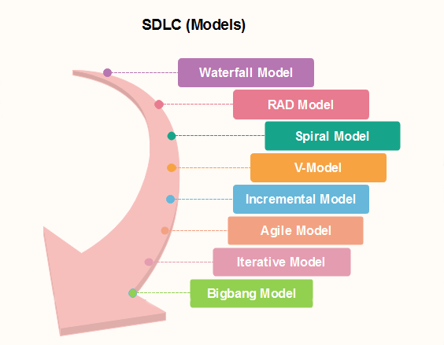
Prescriptive Models

Slide 32
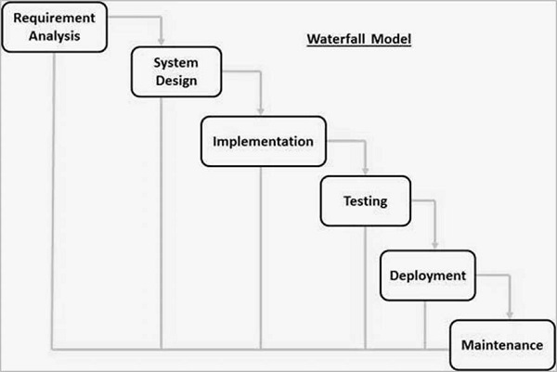
Waterfall Model

Slide 33
Waterfall Model
Requirement Gathering and analysis − All possible requirements of the system to be developed are captured in this phase and documented in a requirement specification document.
System Design − The requirement specifications from first phase are studied in this phase and the system design is prepared. This system design helps in specifying hardware and system requirements and helps in defining the overall system architecture.
Implementation − With inputs from the system design, the system is first developed in small programs called units, which are integrated in the next phase. Each unit is developed and tested for its functionality, which is referred to as Unit Testing.

Slide 34
Waterfall Model
Integration and Testing − All the units developed in the implementation phase are integrated into a system after testing of each unit. Post integration the entire system is tested for any faults and failures.
Deployment of system − Once the functional and non-functional testing is done; the product is deployed in the customer environment or released into the market.
Maintenance − There are some issues which come up in the client environment. To fix those issues, patches are released. Also to enhance the product some better versions are released. Maintenance is done to deliver these changes in the customer environment.

Slide 35
Waterfall Model
Some of the major advantages of the Waterfall Model are as follows −
Simple and easy to understand and use
Easy to manage due to the rigidity of the model. Each phase has specific deliverables and a review process.
Phases are processed and completed one at a time.
Works well for smaller projects where requirements are very well understood.
Clearly defined stages.
Well understood milestones.
Easy to arrange tasks.
Process and results are well documented.

Slide 36
Waterfall Model/Linear Sequential Model
The major disadvantages of the Waterfall Model are as follows −
No working software is produced until late during the life cycle.
High amounts of risk and uncertainty.
Not a good model for complex and object-oriented projects.
Poor model for long and ongoing projects.
Not suitable for the projects where requirements are at a moderate to high risk of changing. So, risk and uncertainty is high with this process model.
It is difficult to measure progress within stages.
Cannot accommodate changing requirements.
Adjusting scope during the life cycle can end a project.
Integration is done as a "big-bang. at the very end, which doesn't allow identifying any technological or business bottleneck or challenges early.

Slide 37
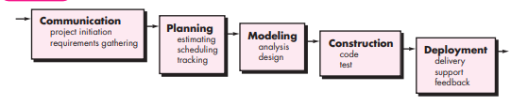
Waterfall Model

Slide 38
V-Model
The V-model is an SDLC model where execution of processes happens in a sequential manner in a V-shape. It is also known as Verification and Validation model.
The V-Model is an extension of the waterfall model and is based on the association of a testing phase for each corresponding development stage. This means that for every single phase in the development cycle, there is a directly associated testing phase. This is a highly-disciplined model and the next phase starts only after completion of the previous phase.

Slide 39
V-Model
The V-model is a software development model that represents the relationship between the different phases of the development process and their corresponding testing activities. It is called the V-model because of its V-shaped diagram, which illustrates the sequential nature of the development and testing phases.
The V-model is based on the concept that testing activities should align with the corresponding development activities. It emphasizes the importance of early and continuous testing throughout the software development life cycle.
The left side of the V represents the development phases, while the right side represents the corresponding testing phases.

Slide 40
V-Model
Requirements Gathering: The process begins with gathering and documenting the software requirements. This phase involves understanding the needs of the stakeholders and defining the software specifications.
System Design: Once the requirements are clear, the system design phase involves translating those requirements into a technical design. It outlines the overall architecture, components, and interfaces of the software system.
Module/Component Design: In this phase, the technical design is further refined at a more granular level. It focuses on designing individual modules or components that make up the system.

Slide 41
V-Model
Coding: The actual implementation of the software takes place in this phase. Developers write the code based on the design specifications.
As we move down the left side of the V-model, we transition to the testing phases on the right side, which mirror the development phases:
Unit Testing: Unit testing verifies the functionality of individual units or components of the software. It aims to identify any defects or issues within these smaller units.
Integration Testing: Integration testing is performed to ensure that the units or components work together as expected when integrated into a larger system. It tests the interactions and interfaces between different modules.

Slide 42
V-Model
System Testing: System testing is conducted on the complete and integrated software system. It verifies whether the system meets the specified requirements and functions as intended.
Acceptance Testing: Acceptance testing is performed to validate the software against the business requirements and ensure that it satisfies the needs of the end-users. It involves real-world scenarios and is typically carried out by the stakeholders.
The V-model emphasizes the idea of testing at each stage of development, with testing activities mirroring the corresponding development activities. This approach helps identify issues earlier in the development life cycle, resulting in reduced rework and higher quality software.

Slide 43
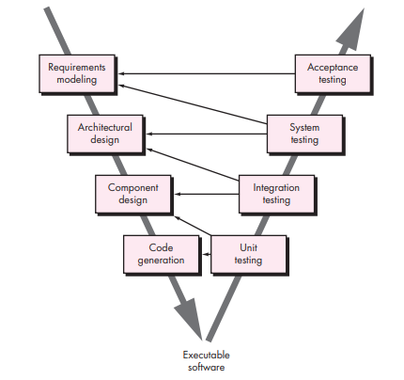
V-Model

Slide 44
Incremental Process Models
The incremental model combines elements of linear and parallel process flows.
Each linear sequenceproduces deliverable “increments” of the software in a manner that is similar to the increments produced by an evolutionary process flow.
When an incremental model is used, the first increment is often a core product.That is, basic requirements are addressed but many supplementary features (some known, others unknown) remain undelivered. The core product is used by the customer (or undergoes detailed evaluation). As a result of use and/or evaluation, a plan is developed for the next increment. The plan addresses the modification of the core product to better meet the needs of the customer and the delivery of additional features and functionality.

Slide 45
Incremental Process Models
Each increment follows this cycle, adding new features and functionality while ensuring that the previously developed components continue to work correctly. With each iteration, the software product grows incrementally until it reaches its final form.
The incremental process model offers several advantages, such as early delivery of working software, continuous feedback from users and stakeholders, and increased flexibility to adapt to changing requirements. It also allows for better risk management and provides opportunities for learning and improvement with each increment.

Slide 46
Incremental Process Models
It's important to note that the number of increments, the duration of each increment, and the specific activities within each increment may vary depending on the project and the development team's needs.
In summary, the incremental process model breaks down the development process into smaller iterations, allowing for the incremental delivery of working software. It offers flexibility, adaptability, and early feedback, leading to a more efficient and successful software development process.

Slide 47
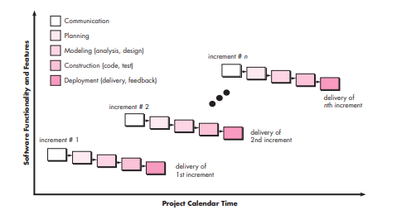
Incremental Process Models

Slide 48
Evolutionary Process Models
Evolutionary models are iterative. They are characterized in a manner that enables you to develop increasingly more complete versions of the software.
Two common evolutionary process models are as follows:

Slide 49
Evolutionary Process Models
The prototyping model is a software development approach that focuses on creating a working prototype of the desired software system. It involves building an initial version of the software with limited functionality to gather feedback, validate requirements, and refine the final system. This model allows for early user involvement, rapid iterations, and continuous improvement.
The prototyping model follows an iterative process where a basic version or prototype of the software is developed and refined through multiple iterations based on user feedback and requirements. The main goal is to quickly build a working model that demonstrates key features and functionalities.

Slide 50
Evolutionary Process Models
Here's how the prototyping model works:
Requirements Gathering: Initially, the requirements are collected from the stakeholders. However, instead of gathering all the detailed requirements upfront, the focus is on identifying the essential features and functionalities that the prototype should demonstrate.
Prototype Development: Based on the identified requirements, a basic version of the software, called the prototype, is developed. The prototype typically has limited functionality but should be able to showcase the core features and interactions.
User Feedback and Evaluation: The developed prototype is presented to the users and stakeholders for evaluation. They provide feedback, suggestions, and identify any necessary changes or additions. This feedback helps in refining the prototype and ensuring that the final product meets their expectations.

Slide 51
Evolutionary Process Models
Iterative Refinement: Based on the feedback received, the prototype is refined through multiple iterations. Each iteration involves making necessary modifications, adding new features, and improving the overall functionality and user experience. The refined prototype becomes the basis for the next iteration.
Final System Development: As the iterations progress and the prototype evolves, the refined prototype gradually transforms into the final software system. The iterations continue until the software meets the desired requirements and satisfies the stakeholders.
The prototyping model allows for flexibility, adaptability, and early user involvement in the development process. It helps in identifying and resolving issues or misunderstandings early on, reducing rework, and ensuring that the final system meets the users' needs effectively.

Slide 52
Evolutionary Process Models
It's important to note that while the prototyping model focuses on creating a working prototype, it does not mean that the prototype will be discarded. In some cases, the prototype may serve as the foundation for the final system, with additional development and enhancements based on user feedback.
In summary, the prototyping model involves developing an initial working version of the software, seeking user feedback, and refining the system through iterative cycles. This approach enables early user involvement, rapid development, and continuous improvement, resulting in a final software system that aligns closely with user expectations.

Slide 53
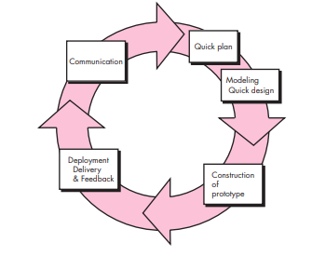
THE PROTOTYPING MODEL

Slide 54
Evolutionary Process Models
The spiral model is a software development model that combines elements of both waterfall and iterative approaches. It emphasizes risk analysis, flexibility, and iterative development. The model consists of cycles or spirals, each representing a phase of the software development process. It allows for continuous refinement and iteration based on feedback and risk assessment.
Risk Identification: The first phase of the spiral model involves identifying and analyzing potential risks and uncertainties associated with the project. This includes understanding requirements, identifying potential problems, and assessing potential impacts on the project's success.

Slide 55
Evolutionary Process Models
Planning: In this phase, a detailed plan is created for the project based on the risk analysis. It includes defining objectives, deliverables, schedules, and resource requirements. The plan is continuously updated and refined as new risks and requirements emerge.
Development and Iteration: This phase involves executing the plan and developing the software in iterations. Each iteration includes requirements analysis, design, coding, testing, and evaluation. The focus is on delivering a working version of the software in each iteration, with additional features and improvements added in subsequent iterations.

Slide 56
Evolutionary Process Models
Risk Assessment: At the end of each iteration, a review is conducted to assess the project's progress, performance, and potential risks. The risks identified in the first phase are reevaluated, and new risks that may have emerged during the iteration are analyzed. Based on the risk assessment, decisions are made to continue with the next iteration, refine the plan, or make necessary adjustments.
Customer Evaluation: After each iteration, the customer or stakeholders evaluate the software and provide feedback. This feedback is crucial in refining the requirements and identifying any necessary changes or improvements. It helps in aligning the software with user expectations and ensures that the final product meets their needs effectively.

Slide 57
Evolutionary Process Models
The spiral model emphasizes continuous refinement and iteration based on risk assessment and customer feedback. It allows for flexibility and adaptability throughout the development process. The project progresses through a series of cycles or spirals, with each spiral building upon the lessons learned from the previous ones.
It's important to note that the number of iterations and the level of detail in each iteration may vary depending on the project's complexity and requirements.
In summary, the spiral model combines risk analysis, iterative development, and customer feedback to guide the software development process. It provides a flexible approach that allows for continuous refinement and adaptation, resulting in a high-quality software product that addresses potential risks and meets user expectations.

Slide 58
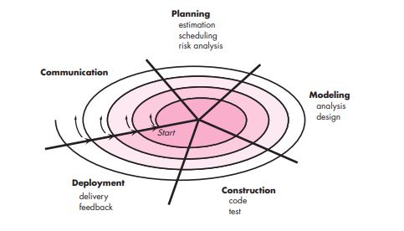
The Spiral Model
Risk
Anchor Point Milestones

Slide 59
Concurrent Models
Concurrent models, in simple terms, refer to software development models that involve the simultaneous execution of different activities or phases of the development process. These models aim to improve efficiency, reduce time, and promote collaboration among team members. Here are two commonly used concurrent models explained in simple terms:
Concurrent Engineering Model: The concurrent engineering model focuses on parallelizing the different phases of the software development process, allowing multiple activities to occur concurrently. In this model, instead of following a strict sequential approach, teams work simultaneously on different aspects of the project. For example, while one team is involved in requirements gathering, another team can start designing or coding based on the preliminary requirements. This promotes better coordination, reduces development time, and facilitates early detection of issues.

Slide 60
Concurrent Models
Agile Development Model: Agile development is a popular concurrent model that emphasizes iterative and incremental development. It breaks down the project into small, manageable units called sprints or iterations. Each iteration typically involves a subset of the development phases, including requirements gathering, design, coding, testing, and evaluation. Teams work concurrently on different iterations, with each iteration producing a potentially shippable increment of the software. This model allows for flexibility, quick feedback cycles, and adaptability to changing requirements.
In both concurrent models, teams work collaboratively, communicate effectively, and ensure synchronization to achieve the project goals. By allowing different activities to occur concurrently, these models aim to expedite the software development process, enhance productivity, and foster better collaboration among team members.

Slide 61
Concurrent Models
It's important to note that concurrent models may require careful planning, coordination, and effective communication to avoid conflicts, ensure proper integration of different activities, and maintain the overall quality of the software product.

Slide 62
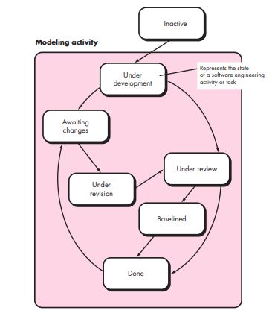
Concurrent Models
‘Design Phase’ may be at an ‘awaiting state’ and ‘customer communication’ is in ‘under revision’ state. The customer wants some changes to the design, then ‘communication’ goes to ‘awaiting changes’ and ‘design’ goes to the under-development stage again.
The benefit of this model is that project managers know each phase is what state and why.
Main Point – Maintain information about each phase at the activity level.

Slide 63
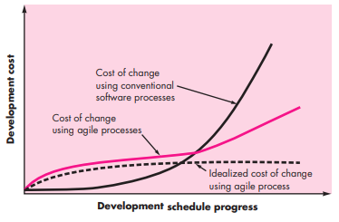
WHAT I S AGILITY?
Agile is the ability to create and respond to change. It is a way of dealing with, and ultimately succeeding in, an uncertain and turbulent environment.
Software engineers must be quick on their feet if they are to accommodate the rapid changes

Slide 64
AGILE PRINCIPLES
1.Our highest priority is to satisfy the customer through early and continuous delivery of valuable software.
2. Welcome changing requirements, even late in development. Agile processes harness change for the customer’s competitive advantage.
3. Deliver working software frequently, from a couple of weeks to a couple of months, with a preference to the shorter timescale.
4. Business people and developers must work together daily throughout the project.

Slide 65
AGILE PRINCIPLES
5. Build projects around motivated individuals. Give them the environment and support they need, and trust them to get the job done.
6. The most efficient and effective method of conveying information to and within a development team is face-to-face conversation.
7. Working software is the primary measure of progress.
8. Agile processes promote sustainable development. The sponsors, developers,and users should be able to maintain a constant pace indefinitely.

Slide 66
AGILE PRINCIPLES
9.Continuous attention to technical excellence and good design enhances agility.
10. Simplicity—the art of maximizing the amount of work not done—is essential.
11. The best architectures, requirements, and designs emerge from self–organizing teams.
12. At regular intervals, the team reflects on how to become more effective, then tunes and adjusts its behavior accordingly.

Slide 67
WHAT I S AGILITY?
1. It is difficult to predict in advance which software requirements will persistand which will change. It is equally difficult to predict how customerpriorities will change as the project proceeds.
2. For many types of software, design and construction are interleaved. That is,both activities should be performed in tandem so that design models are proven as they are created. It is difficult to predict how much design is necessary before construction is used to prove the design.
3. Analysis, design, construction, and testing are not as predictable (from a planning point of view) as we might like

Slide 68
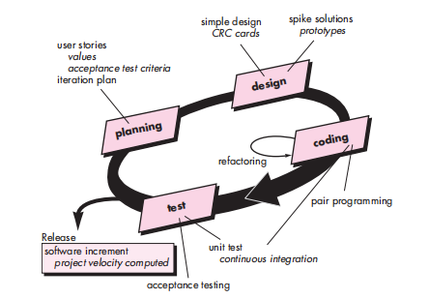
Extreme Programming

Slide 69
Extreme Programming
Extreme Programming (XP) is an Agile software development methodology that emphasizes close collaboration, continuous feedback, and iterative development. It focuses on delivering high-quality software through practices that promote teamwork, simplicity, and adaptability.
Extreme Programming (XP) involves a set of core practices and values that guide the development process. These practices are designed to enable teams to respond quickly to changing requirements, produce high-quality code, and maintain a sustainable pace of work.
The core values of Extreme Programming (XP) are:
Communication: XP emphasizes effective communication and collaboration among team members, stakeholders, and customers. Frequent and open communication helps to ensure that everyone is aligned, understands the requirements, and can make informed decisions.

Slide 70
Extreme Programming
Simplicity: XP advocates for simplicity in both code and processes. The focus is on delivering the simplest solution that fulfills the requirements, avoiding unnecessary complexity that could lead to errors or difficulties in maintaining the codebase.
Feedback: Continuous feedback is crucial in XP. It involves getting feedback from customers, stakeholders, and team members throughout the development process to refine and improve the software. Feedback loops are used to validate the implemented functionality and make necessary adjustments.
Courage: XP encourages team members to have the courage to make decisions, take ownership of their work, and continuously improve. This value promotes an environment where individuals feel empowered to voice their ideas, experiment, and make necessary changes.

Slide 71
Extreme Programming
Respect: XP fosters a culture of respect among team members. It values the expertise and opinions of each team member and encourages a collaborative and supportive environment.
The core practices of Extreme Programming (XP) include:
Test-Driven Development (TDD): Developers write tests before writing the code. It helps ensure that the code is functional, maintainable, and robust.
Pair Programming: Two developers work together on the same task, with one writing the code and the other reviewing it. Pair programming promotes knowledge sharing, code quality, and collaboration.
Continuous Integration: Developers frequently integrate their code changes into a shared repository. It allows for early detection of integration issues and maintains a working and stable codebase.

Slide 72
Extreme Programming
Refactoring: Code is continuously improved without changing its external behavior. Refactoring helps keep the codebase clean, maintainable, and adaptable to future changes.
Small Releases: Software is released in small increments, allowing for early and frequent delivery of functionality. This practice enables stakeholders to provide feedback and helps validate assumptions.

Slide 73
Requirements engineering
The broad spectrum of tasks and techniques that lead to an understanding of requirements is called requirements engineering.
Requirements engineering provides the appropriate mechanism for understanding what the customer wants, analyzing need, assessing feasibility, negotiating a reasonable solution, specifying the solution unambiguously, validating the specification, and managing the requirements as they are transformed into an operational system

Slide 74
Requirements engineering
It encompasses seven distinct tasks: inception, elicitation, elaboration, negotiation, specification, validation, and management. It is important to note that some of these tasks occur in parallel and all are adapted to the needs of the project.

Slide 75
Inception
At project inception, you establish a basic understanding of the problem, the people who want a solution, the nature of the solution that is desired, and the effectiveness of preliminary communication and collaboration between the other stakeholders and the software team

Slide 76
Feasibility study
When the client approaches the organization for getting the desired product developed, it comes up with rough idea about what all functions the software must perform and which all features are expected from the software.
Referencing to this information, the analysts does a detailed study about whether the desired system and its functionality are feasible to develop.

Slide 77
Elicitation
This is also known as the gathering of requirements. Here, requirements are identified with the help of customers and existing systems processes, if available.
Analysis of requirements starts with requirement elicitation. The requirements are analyzed to identify inconsistencies, defects, omission, etc. We describe requirements in terms of relationships and also resolve conflicts if any.

Slide 78
Elicitation
Requirements Elicitation is the process to find out the requirements for an intended software system by communicating with client, end users, system users and others who have a stake in the software system development.
There are various ways to discover requirements

Slide 79
Elicitation
Interviews
Interviews are strong medium to collect requirements. Organization may conduct several types of interviews such as:
Structured (closed) interviews, where every single information to gather is decided in advance, they follow pattern and matter of discussion firmly.
Non-structured (open) interviews, where information to gather is not decided in advance, more flexible and less biased.

Slide 80
Elicitation
Oral interviews
Written interviews
One-to-one interviews which are held between two persons across the table.
Group interviews which are held between groups of participants. They help to uncover any missing requirement as numerous people are involved.

Slide 81
Elicitation
Surveys
Organization may conduct surveys among various stakeholders by querying about their expectation and requirements from the upcoming system.

Slide 82
Elicitation
Questionnaires
A document with pre-defined set of objective questions and respective options is handed over to all stakeholders to answer, which are collected and compiled.
A shortcoming of this technique is, if an option for some issue is not mentioned in the questionnaire, the issue might be left unattended.

Slide 83
Elicitation
Task analysis
Team of engineers and developers may analyze the operation for which the new system is required. If the client already has some software to perform certain operation, it is studied and requirements of proposed system are collected.
Domain Analysis
Every software falls into some domain category. The expert people in the domain can be a great help to analyze general and specific requirements.

Slide 84
Elicitation
Brainstorming
An informal debate is held among various stakeholders and all their inputs are recorded for further requirements analysis.

Slide 85
Elicitation
Observation
Team of experts visit the client’s organization or workplace. They observe the actual working of the existing installed systems. They observe the workflow at client’s end and how execution problems are dealt. The team itself draws some conclusions which aid to form requirements expected from the software.

Slide 86
Elicitation
Problems of Elicitation and Analysis:
Getting all, and only, the right people involved.
Stakeholders often don't know what they want
Stakeholders express requirements in their terms.
Stakeholders may have conflicting requirements.
Requirement change during the analysis process.
Organizational and political factors may influence system requirements.

Slide 87
Elaboration
The information obtained from the customer during inception and elicitation is expanded and refined during elaboration. This task focuses on developing a refined requirements model that identifies various aspects of software function, behavior, and information.

Slide 88
Negotiation
It isn’t unusual for customers and users to ask for more than can be
achieved, given limited business resources. It’s also relatively common for different customers or users to propose conflicting requirements, arguing that their version is “essential for our special needs.” You have to reconcile these conflicts through a process of negotiation.

Slide 89
Specification
A specification can be a written document, a set of graphical models, a formal mathematical model, a collection of usage scenarios, a prototype, or any combination of these.

Slide 90
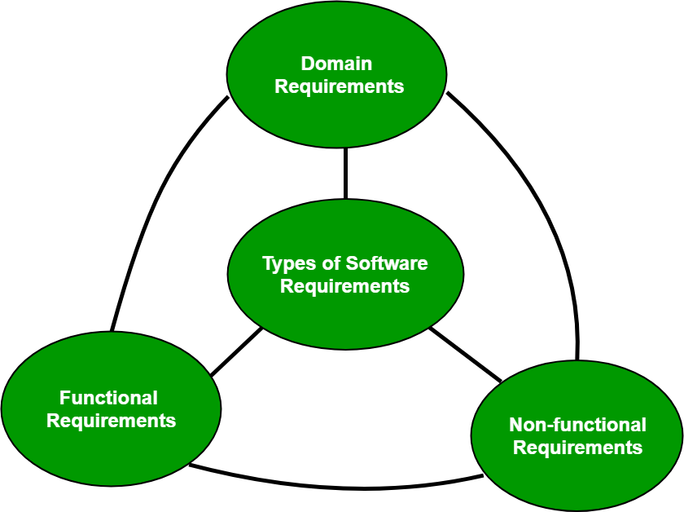
Software requirement
A software requirement can be of 3 types:
Functional requirements
Non-functional requirements
Domain requirements

Slide 91
Software requirement
Functional Requirements:
In software engineering, a functional requirement defines a system or its component. It describes the functions a software must perform. A function is nothing but inputs, its behavior, and outputs. It can be a calculation, data manipulation, business process, user interaction, or any other specific functionality which defines what function a system is likely to perform.
Functional requirements in software engineering help you to capture the intended behavior of the system. This behavior may be expressed as functions, services or tasks or which system is required to perform.

Slide 92
Software requirement
Non-Functional Requirement
A non-functional requirement defines the quality attribute of a software system. They represent a set of standards used to judge the specific operation of a system. Example, how fast does the website load? A non-functional requirement is essential to ensure the usability and effectiveness of the entire software system. Failing to meet non-functional requirements can result in systems that fail to satisfy user needs.
Non-functional Requirements allows you to impose constraints or restrictions on the design of the system across the various agile backlogs. Example, the site should load in 3 seconds when the number of simultaneous users are > 10000.

Slide 93
Software requirement
Types of Non-functional requirement are Scalability Capacity, Availability, Reliability, Recoverability, Data Integrity, etc. whereas transaction corrections, adjustments, and cancellations, Business Rules, Certification Requirements, Reporting Requirements, Administrative functions, Authorization levels, Audit Tracking, External Interfaces, Historical Data management, Legal or Regulatory Requirements are various types of functional requirements.

Slide 94
Software Requirements Specification (SRS)
software requirements specification (SRS):
A software requirements specification (SRS) is a document that describes what the software will do and how it will be expected to perform. It also describes the functionality the product needs to fulfill all stakeholders (business, users) needs.

Slide 95
Software Requirements Specification (SRS)
An SRS minimizes the time and effort required by developers to achieve desired goals and also minimizes the development cost. A good SRS defines how an application will interact with system hardware, other programs and human users in a wide variety of real-world situations. Parameters such as operating speed, response time, availability, portability, maintainability, footprint, security and speed of recovery from adverse events are evaluated. Methods of defining an SRS are described by the IEEE (Institute of Electrical and Electronics Engineers) specification 830-1998.

Slide 96
Quality Characteristics of a good SRS
Correctness:
User review is used to ensure the correctness of requirements stated in the SRS. SRS is said to be correct if it covers all the requirements that are actually expected from the system.
Completeness:
Completeness of SRS indicates every sense of completion including the numbering of all the pages, resolving the to be determined parts to as much extent as possible as well as covering all the functional and non-functional requirements properly.

Slide 97
Quality Characteristics of a good SRS
Consistency:
Requirements in SRS are said to be consistent if there are no conflicts between any set of requirements. Examples of conflict include differences in terminologies used at separate places, logical conflicts like time period of report generation, etc.
Unambiguousness:
A SRS is said to be unambiguous if all the requirements stated have only 1 interpretation. Some of the ways to prevent unambiguousness include the use of modelling techniques like ER diagrams, proper reviews and buddy checks, etc.

Slide 98
Quality Characteristics of a good SRS
Ranking for importance and stability:
There should a criterion to classify the requirements as less or more important or more specifically as desirable or essential. An identifier mark can be used with every requirement to indicate its rank or stability.
Modifiability:
SRS should be made as modifiable as possible and should be capable of easily accepting changes to the system to some extent. Modifications should be properly indexed and cross-referenced.

Slide 99
Quality Characteristics of a good SRS
Verifiability:
A SRS is verifiable if there exists a specific technique to quantifiably measure the extent to which every requirement is met by the system. For example, a requirement starting that the system must be user-friendly is not verifiable and listing such requirements should be avoided.
Traceability:
One should be able to trace a requirement to design component and then to code segment in the program. Similarly, one should be able to trace a requirement to the corresponding test cases.

Slide 100
Quality Characteristics of a good SRS
Design Independence:
There should be an option to choose from multiple design alternatives for the final system. More specifically, the SRS should not include any implementation details.
Testability:
A SRS should be written in such a way that it is easy to generate test cases and test plans from the document.

Slide 101
Quality Characteristics of a good SRS
Understandable by the customer:
An end user maybe an expert in his/her specific domain but might not be an expert in computer science. Hence, the use of formal notations and symbols should be avoided to as much extent as possible. The language should be kept easy and clear.
Right level of abstraction:
If the SRS is written for the requirements phase, the details should be explained explicitly. Whereas, for a feasibility study, fewer details can be used. Hence, the level of abstraction varies according to the purpose of the SRS.

Slide 102
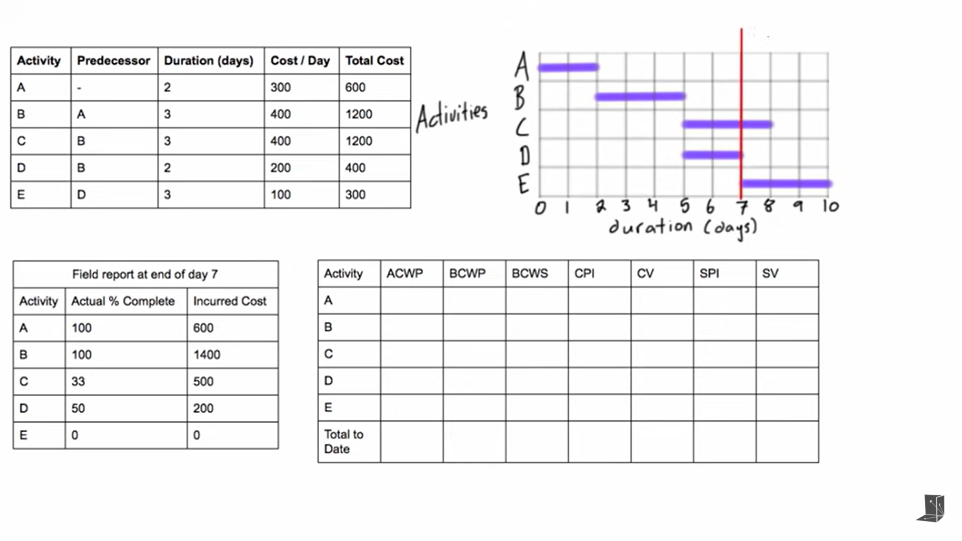
Earned Value Analysis

Slide 103
Earned Value Analysis
ACWP- Actual Cost of Work Performed: How much we paid for the work done so far

Slide 104
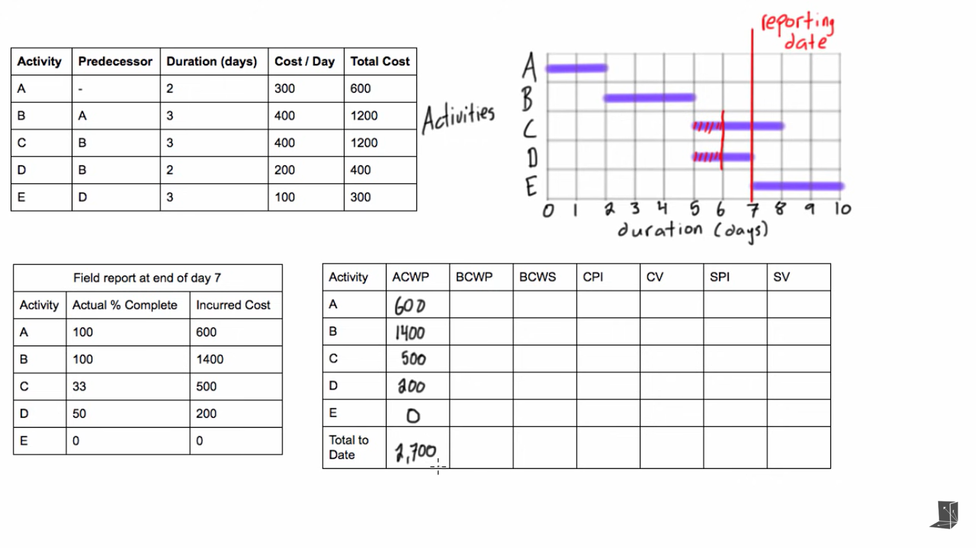
Earned Value Analysis

Slide 105
Earned Value Analysis
BCWP- Budgeted Cost of Work Performed: How much money we are expecting to pay for the amount of work that was actually completed

Slide 106
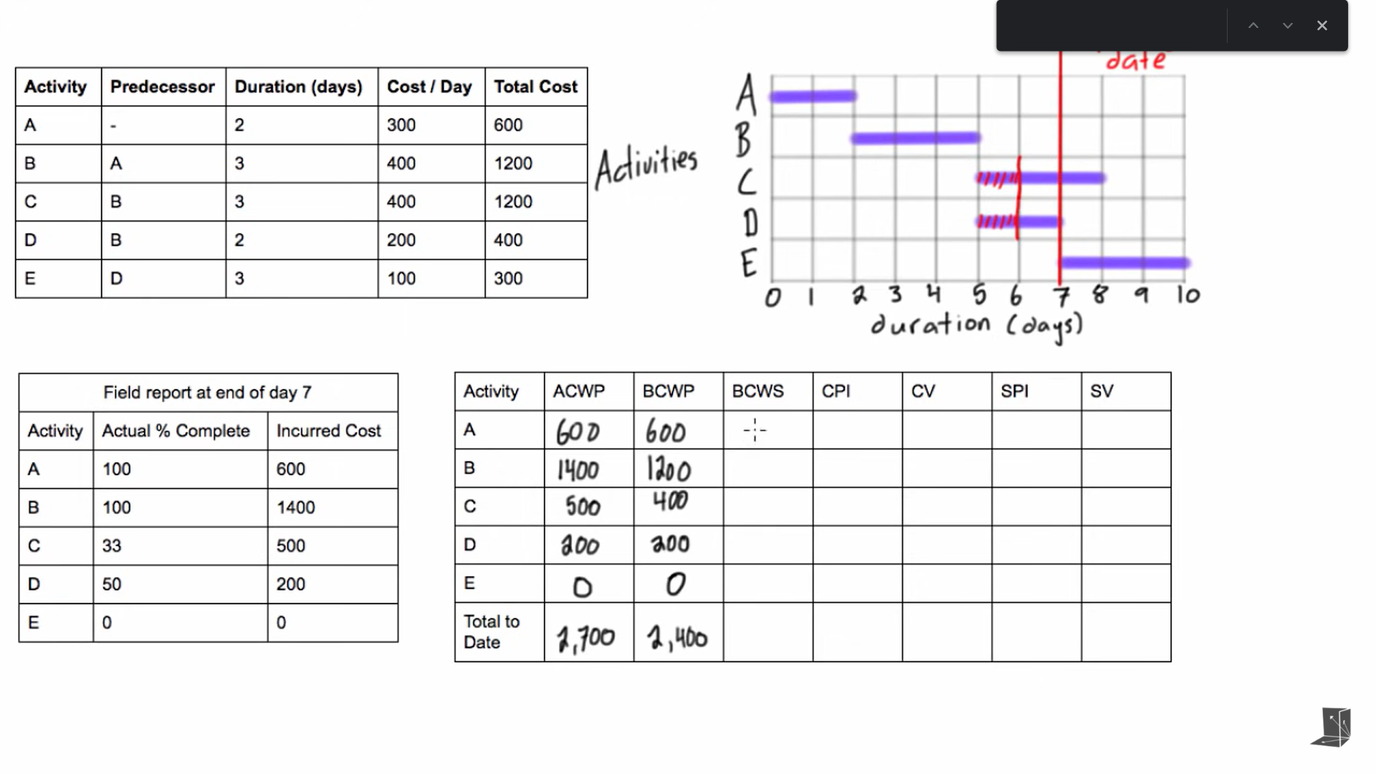
Earned Value Analysis

Slide 107
Earned Value Analysis
BCWS- Budgeted Cost of Work Scheduled: How much we expected to pay for each activity that we had expected to finish by the reporting date.

Slide 108
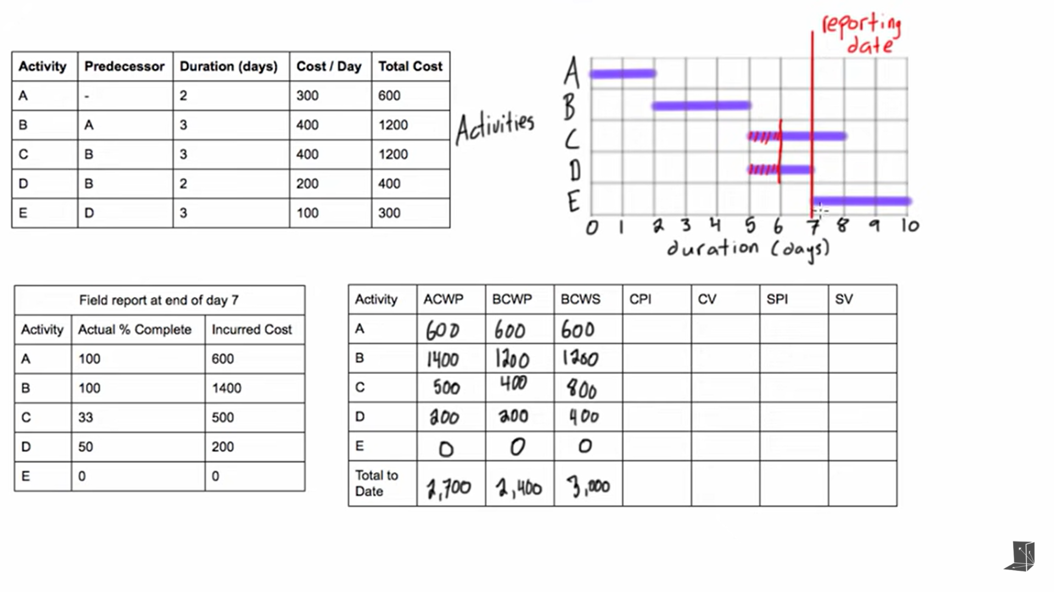
Earned Value Analysis

Slide 109
Earned Value Analysis
CPI(Cost Performance Index)= BCPW/ACPW
CV(Cost Variance) = BCPW-ACPW
SPI(Schedule Performance Index)= BCWP/BCWS
SV(Schedule Variance)= BCWP-BCWS

Slide 110
Earned Value Analysis
CPI<1
Project is over budget
CV<0
Project is over budget
SPI<1
Project is behind Schedule
SPI<0
Project is behind schedule

Slide 111
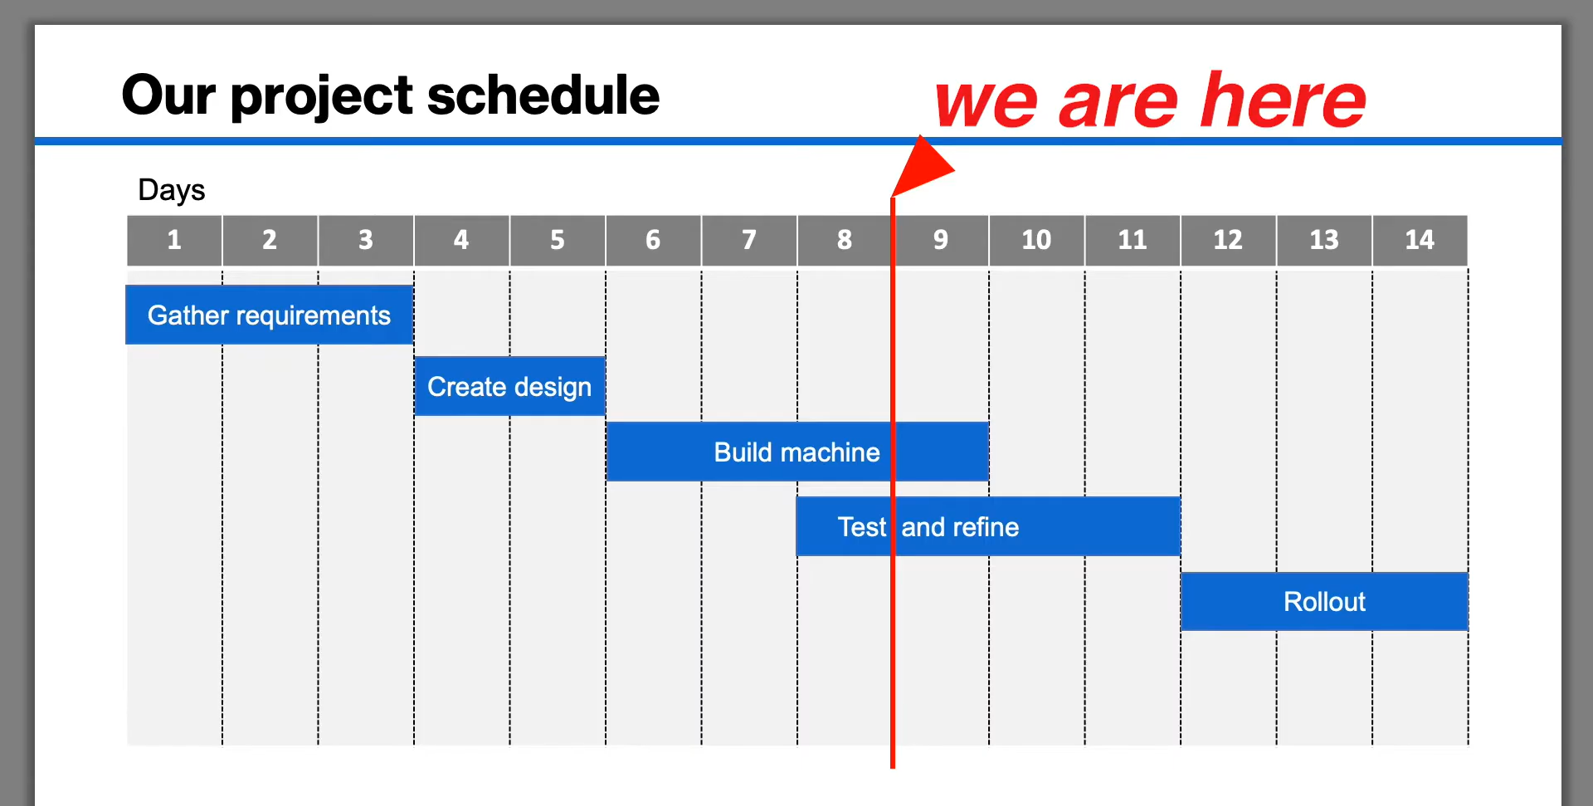
Earned Value Analysis

Slide 112
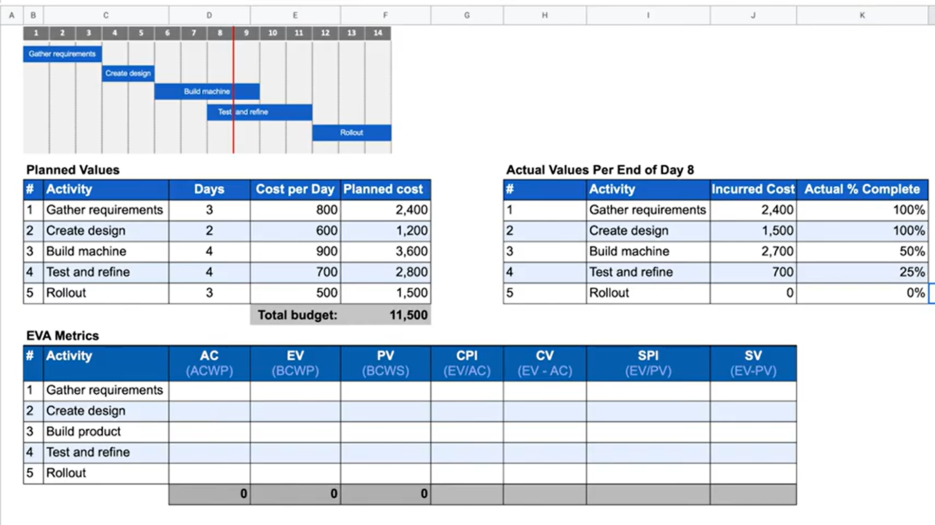
Earned Value Analysis

